Slide 1
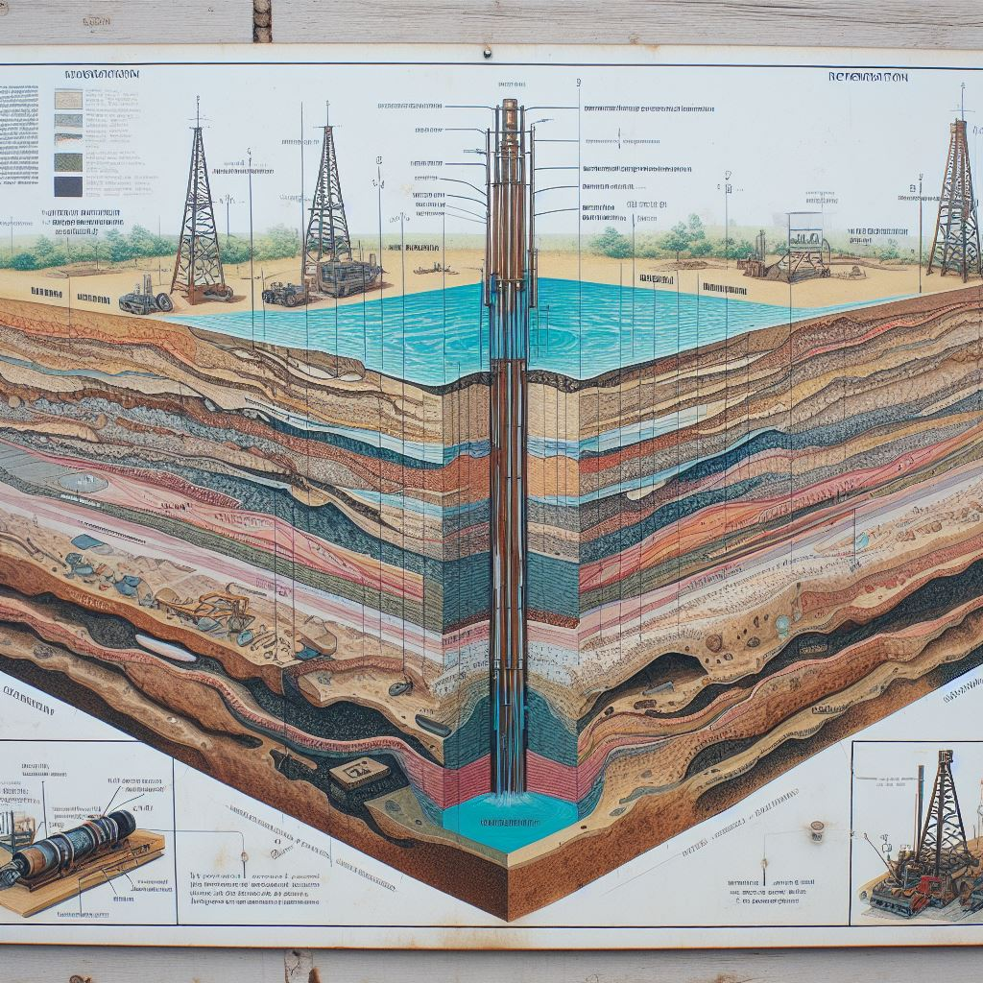

A Case Study: Gorgonichthys_1 Well in Browse Basin of NWS, Australia
Course: Formation Evaluation (GPD502)
Instructor: Prof Partha Pratim Mandal
Group Members:
Deyasini Mitra
Ravi Tej
Shreya Hembrom
Sushanta Ghosh
7 Nov, 2023

Slide 2
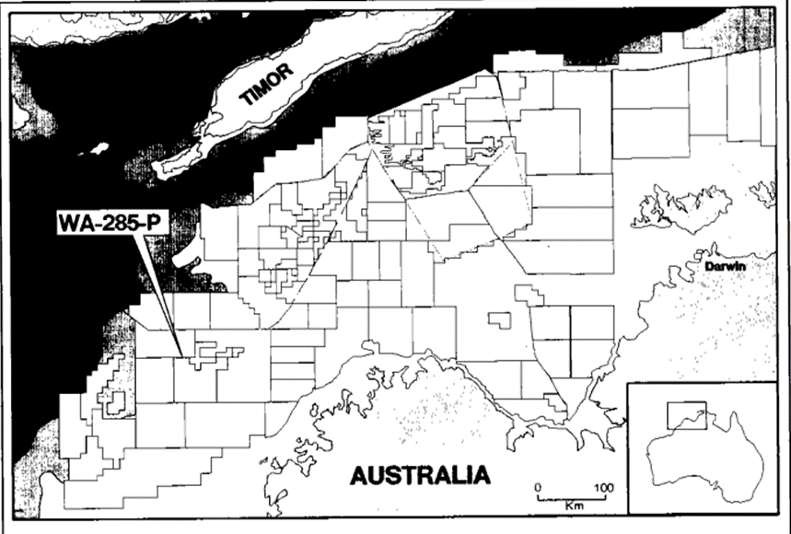
Introduction
Gorgonichthys 1 Well
Location: Browse Basin (offshore), NWS, Australia
BREWSTER MEMBER DEPTH 3900 m – 4200 M
The Brewster Member of the Upper Vulcan Formation is the main reservoir for the Gorgonichthys gas accumulations.
Objectives
Optimization of total porosity calculation (combination of neutron and density log) after calibrating with core data.
Calculation of water saturation with Archie and Simandoux methods respectively and comparison.
Estimation of NTG ratio (Given Cutoffs: Vsh < 50%, φ > 5% and Sw < 50%).
Building an empirical porosity-permeability relationship from core data (Discarding anomalous data point during regression analysis).

Slide 3
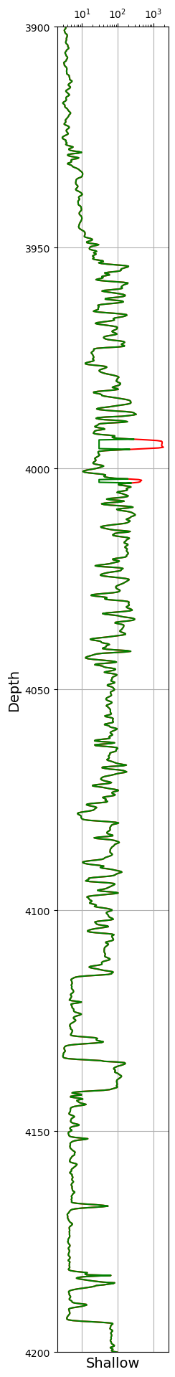
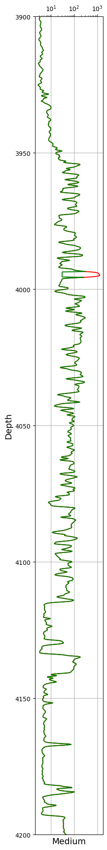
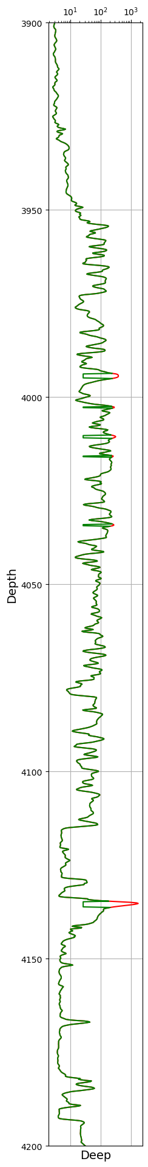
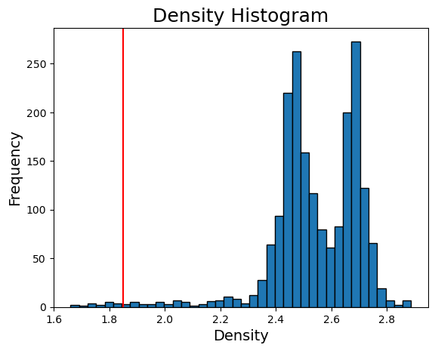
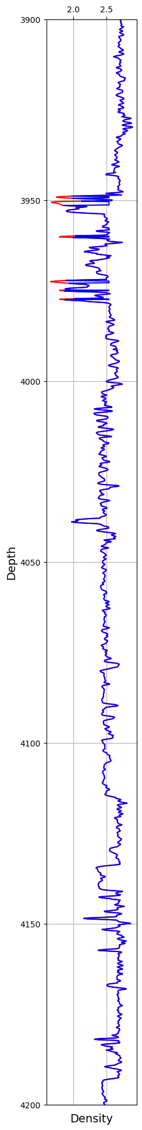
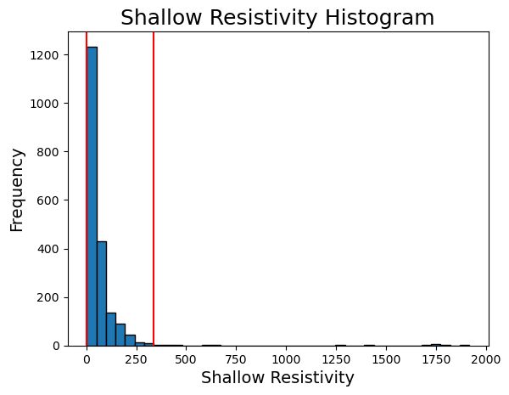
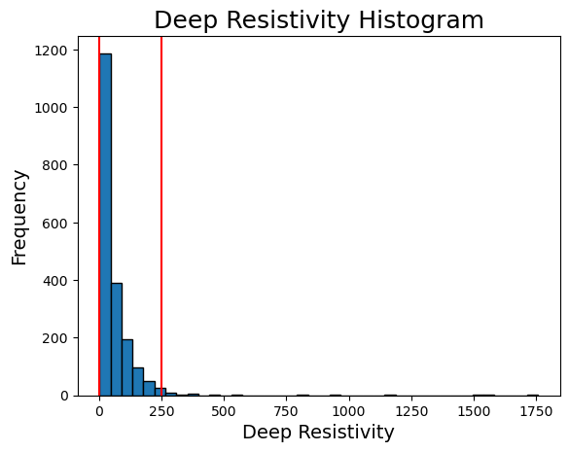
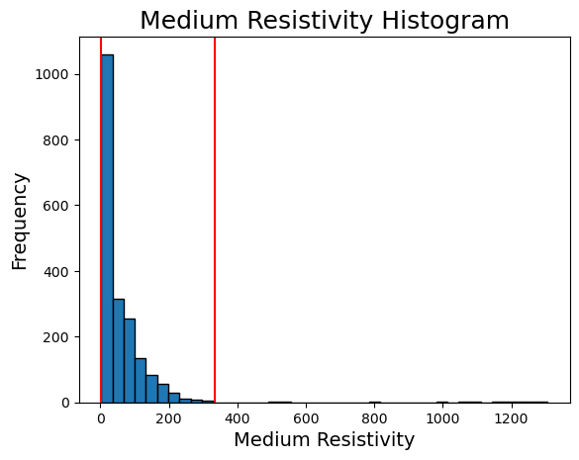
Quality Control
Density
Shallow Resistivity
Medium Resistivity
Deep Resistivity
3900
2.5
2.0
3950
4000
Outlier data Removal
4050
4100
4150
4200

Slide 4
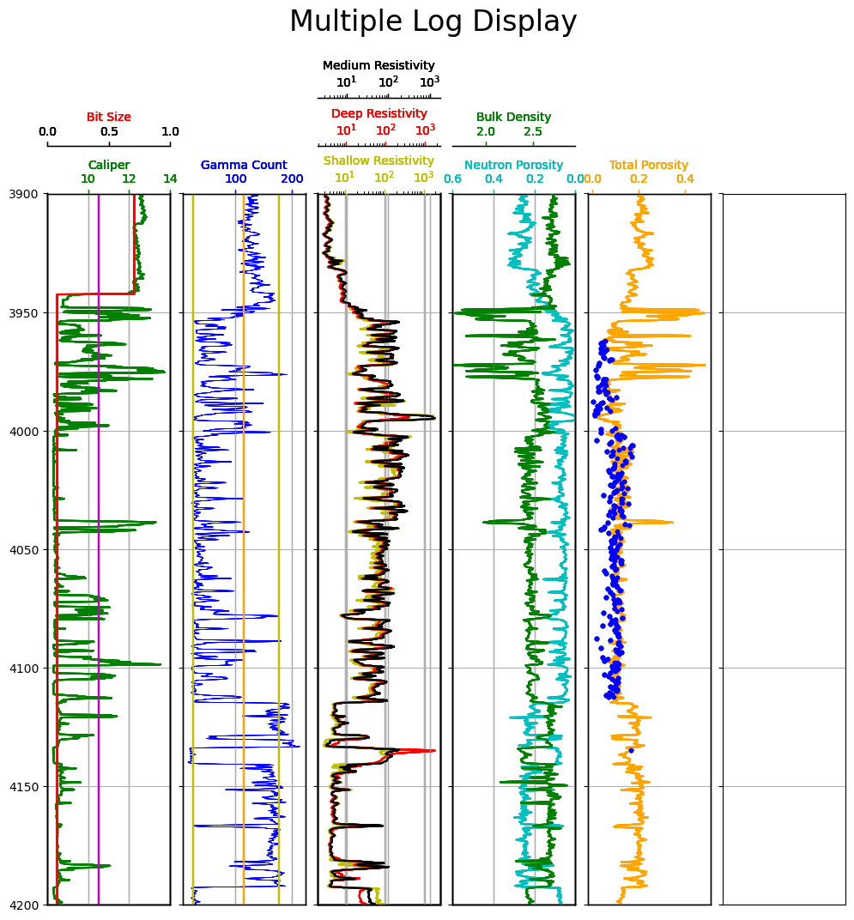
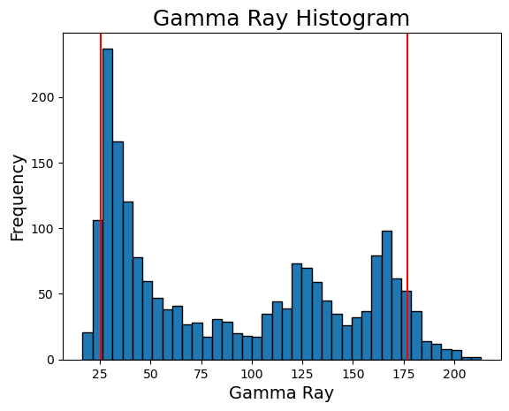
Quality Control
3900
Sand line
3950
Shale line
4000
4050
Bad borehole Flagging = 1
when Caliper > Bit Size + 2.5 inches
Not
Outliers!
4100
4150
4200

Slide 5
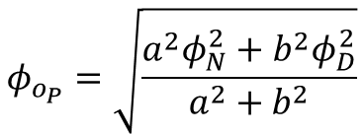
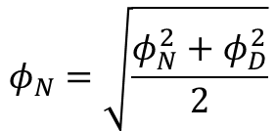
Total Porosity Optimization & Calibration Water Saturation Calculation NTG Estimation Porosity-permeability Relationship
Total Porosity Optimization & Calibration Water Saturation Calculation NTG Estimation Porosity-permeability Relationship
Gas Bearing Zone
Core Porosity
Total porosity is calculated accordingly,
$$φ_{N}=\sqrt{\frac{φ_{N}^{2}+φ_{D}^{2}}{2}}$$
and gas corrections are made.
To Optimise
Caving: Data quality compromised!
Assumption,
$$φ_{o_{P}}=\sqrt{\frac{a^{2}φ_{N}^{2}+b^{2}φ_{D}^{2}}{a^{2}+b^{2}}}$$
a and b to be evaluated.

Slide 6
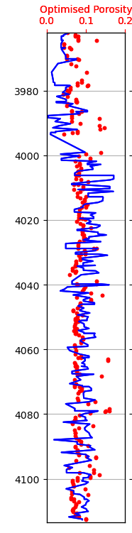
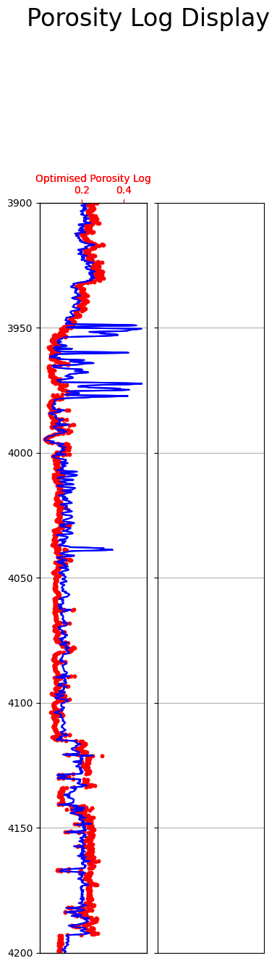
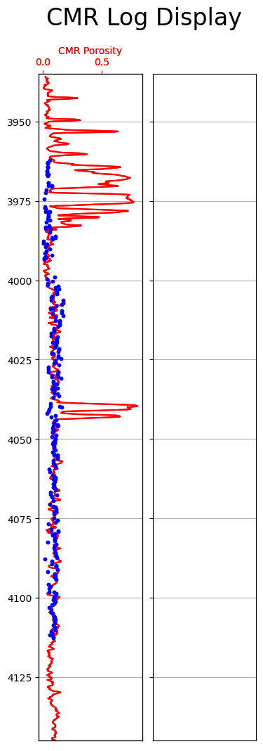
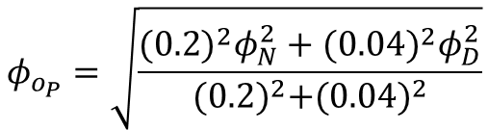
Total Porosity Optimization & Calibration Water Saturation Calculation NTG Estimation Porosity-permeability Relationship
Core Porosity
Total Porosity
Core Porosity
Optimization Results
1
2
3
a = 0.2
b = 0.04
Calibrated Total Porosity
$$φ_{o_{P}}=\sqrt{\frac{{(0.2)}^{2}φ_{N}^{2}+{(0.04)}^{2}φ_{D}^{2}}{{(0.2)}^{2}+{(0.04)}^{2}}}$$

Slide 7
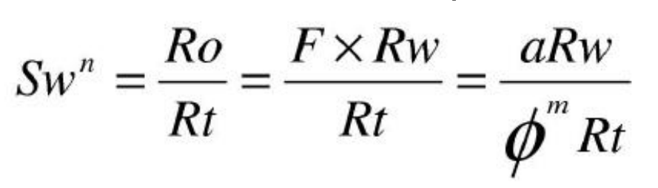
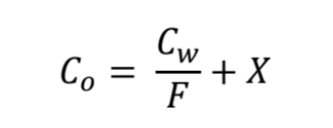
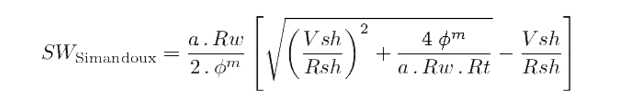
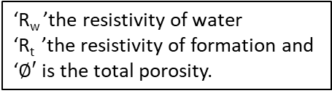
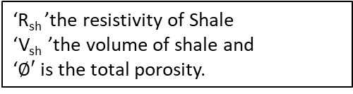

Total Porosity Optimization & Calibration Water Saturation Calculation NTG Estimation Porosity-permeability Relationship
Archie’s Method
Simandoux Method
For Shaly Sand Formation
Clay minerals introduces an additional conductivity into sandstones.
‘a’ the tortuosity factor
‘m’ the cement exponent
‘n’ the saturation exponent
‘R_{w} ’the resistivity of water
‘R_{t} ’the resistivity of formation and
‘$∅′$is the total porosity.
For m = n =2 & a =1
‘R_{sh} ’the resistivity of Shale
‘V_{sh} ’the volume of shale and
‘$∅′$is the total porosity.
S_{w} =$\sqrt{\frac{R_{w}}{∅^{2}R_{t}}}$

Slide 8
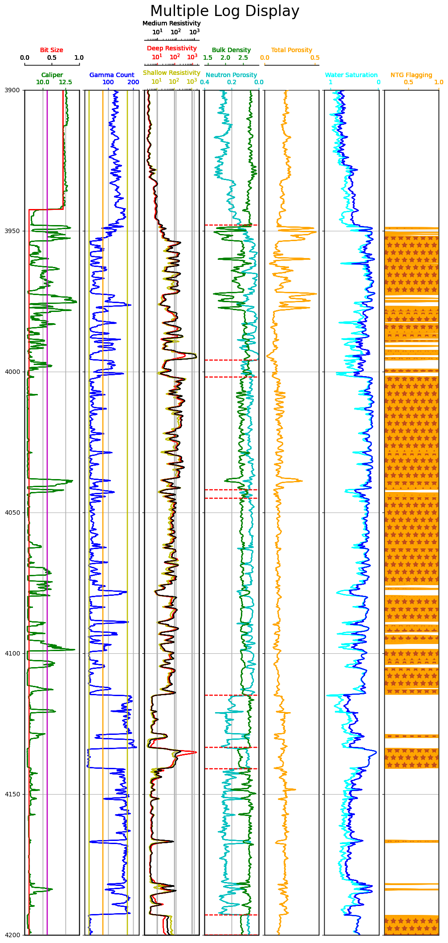
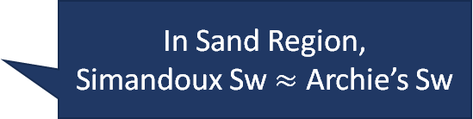
Total Porosity Optimization & Calibration Water Saturation Calculation NTG Estimation Porosity-permeability Relationship
Water Saturation
3900
Simandoux Method
Archie’s Method
3950
4000
Comparison
4050
In Sand Region,
Simandoux Sw $≈$ Archie’s Sw
4100
4150
In shale Region,
Simandoux Sw < Archie’s Sw
4200

Slide 9
Total Porosity Optimization & Calibration Water Saturation Calculation NTG Estimation Porosity-permeability Relationship
NTG ( Net-to-Gross Ratio)
Proportion of productive, porous rock (net) compared to the total rock volume (gross) in a reservoir
For (Vcl<=Vclcut) and (PHIE>=PHIEcut) and (Sw<Swcut)
PAYFLAG=1
Hnetp = Sum(PAYFLAG* .1524) = Net Pay
Gross= Zone_bottom – Zone_top
NTG = Hnetp/Gross

Slide 10
Total Porosity Calibration & Optimization Water Saturation Calculation NTG Estimation Porosity-permeability Relationship
NTG Flagging
Conditions
NTG Flagging
3900
3950
4000
Vsh < 50%,
φ > 5% and
Sw < 50%
4050
4100
NTG ratio
= 0.8452
4150
4200

Slide 11
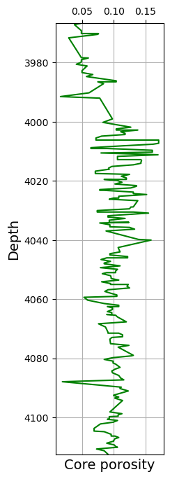
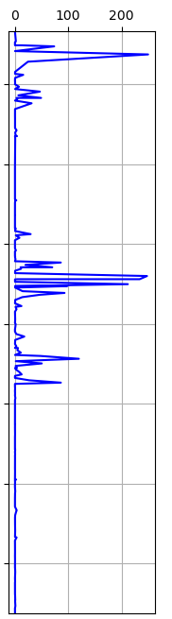
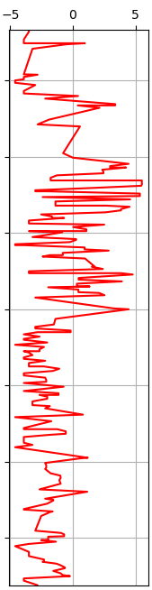
Total Porosity Optimization & Calibration Water Saturation Calculation NTG Estimation Porosity-permeability Relationship
Porosity
Permeability
log(Permeability)
Core Measurements :
Extraction from core list
Porosity
Permeability (Air)
Sorting depth wise
Nan value removal
Plot
Log plot usage to capture the variations

Slide 12
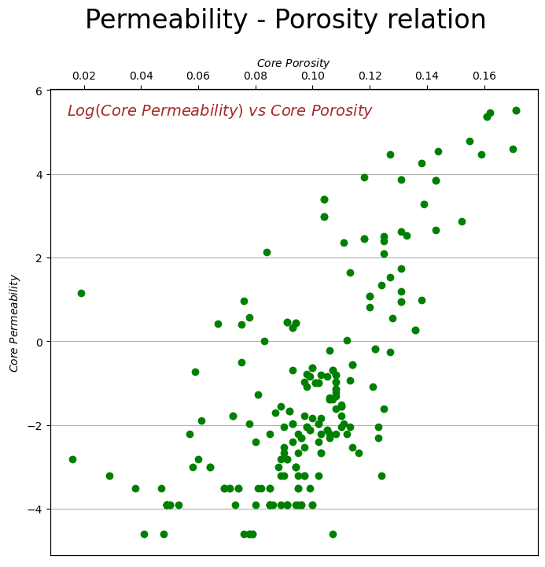
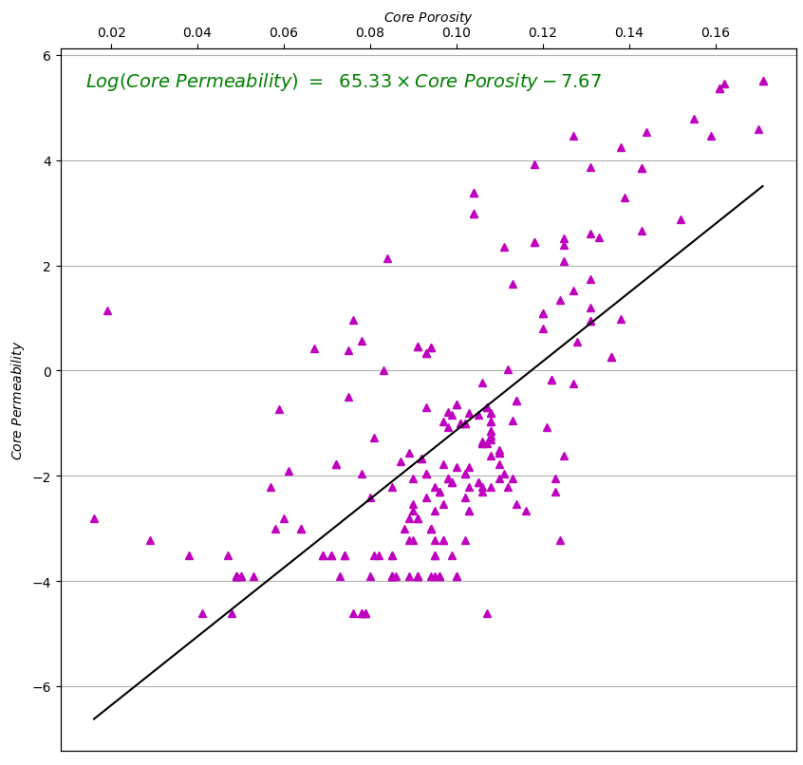
Total Porosity Optimization & Calibration Water Saturation Calculation NTG Estimation Porosity-permeability Relationship
Homogenous Formation
Linear best fit line
Slope = 65.33
Intercept = -7.67

Slide 13
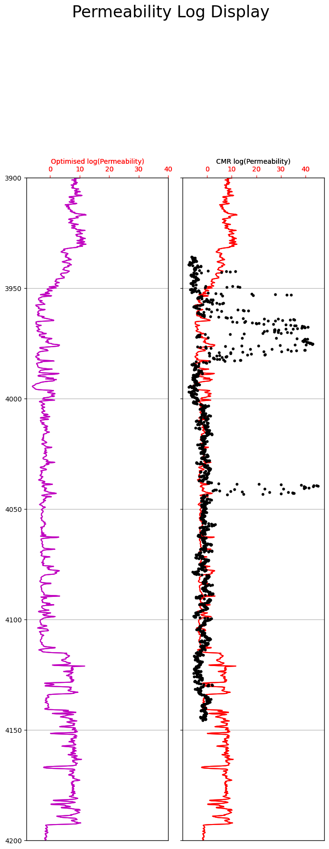
Total Porosity Optimization & Calibration Water Saturation Calculation NTG Estimation Porosity-permeability Relationship
Optimized Permeability
CMR Permeability
3900
Optimized porosity application
Prediction of Permeability
Plot of continous Permeability log
CMR porosity application
Prediction of Permeability
Comparison
3950
4000
4050
4100
4150
4200

Slide 14
Reference
Openhole Log Analysis and Formation Evaluation By: Richard M. Bateman https://doi.org/10.2118/9781613991565
Theys, Philippe P. Log data acquisition and quality control. Editions Technip, 1999.
Munir, M.N., Zafar, M. & Ehsan, M. Comparative and Statistical Analysis of Core-Calibrated Porosity with Log-Derived Porosity for Reservoir Parameters Estimation of the Zamzama GAS Field, Southern Indus Basin, Pakistan. Arab J Sci Eng 48, 7867–7882 (2023). https://doi.org/10.1007/s13369-022-07523-9
Mandal, Partha & Essa, Iman & Saha, Sankhajit & Rezaee, Reza. (2021). Multi-purpose utility of constructing 3D static geomechanical model in the Ichthys field, Browse Basin.
Shahrina, R. J. R. K., et al. "Comparison of Water Saturation Models Based on Well Logging Data: A Case Study of MX Field in Malay Basin." J. Kejuruter 34 (2022): 101-108.
Abbott, Stephen & Khider, Kamal & Kellman, Andrew & Romine, Karen. (2016). Facies architecture of the K10 supersequence in the browse Basin: when sequence stratigraphy meets lithostratigraphy.
S. Bloch; Empirical Prediction of Porosity and Permeability in Sandstones. AAPG Bulletin 1991;; 75 (7): 1145–1160. doi: https://doi.org/10.1306/0C9B28E9-1710-11D7-8645000102C1865D

Slide 15
Acknowledgement
We extend our appreciation to Professor Partha Pratim Mandal for his guidance as the course instructor during this case study. We would also like to acknowledge Western Australian Petroleum and Geothermal Information Management System (WAPIMS) for giving open access to the well log data.
You !
Thank

